Slide 1

Mapper!
Nicholas Della Pesca (Vassar College)
Aine Doherty (Vassar College)
Halley Fritze (University of Oregon)
Maja Gwozdz (ETH Zürich)
Supervisors: Dr Robin Belton and Dr Enrique Alvarado
Course: Projects in TDA, winter 2024

Slide 2
Outline
Background
A review of Mapper
Any graph is a mapper graph
Question 1
On convex sets in Euclidean space
Question 2
On the Probability Space of Mapper for Points on a Line
Future Work

Slide 3
Mapper
Soft clustering algorithm represented as a graph.

Slide 4
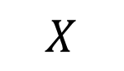
Mapper
Soft clustering algorithm represented as a graph.
$$X$$

Slide 5


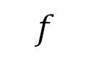
Mapper
Soft clustering algorithm represented as a graph.
Given a filter $f:X→ℝ^{n}$
$$f$$
$$X$$
$$ℝ$$

Slide 6
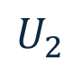




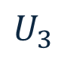
Mapper
Soft clustering algorithm represented as a graph.
Given a filter $f:X→ℝ^{n}$, cover $𝒰={\left\{U_{i}\right\}}_{i∈I}$ of $f(X)$,
$$𝒰$$
$$U_{1}$$
$$f$$
$$U_{2}$$
$$U_{3}$$
$$X$$
$$U_{4}$$
$$ℝ$$

Slide 7
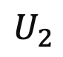
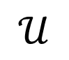
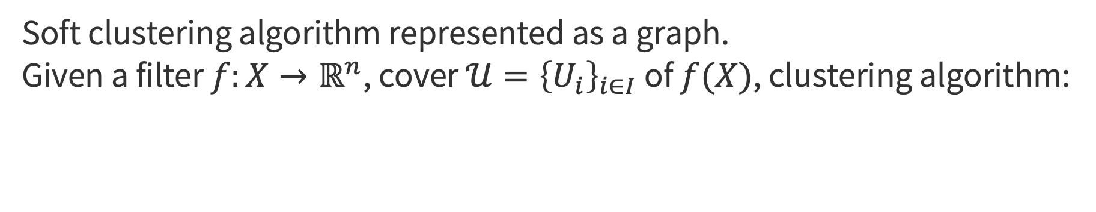
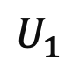
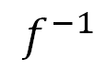
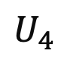
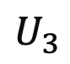
Mapper
Soft clustering algorithm represented as a graph.
Given a filter $f:X→ℝ^{n}$, cover $𝒰={\left\{U_{i}\right\}}_{i∈I}$ of $f(X)$, clustering algorithm:
$$𝒰$$
$$U_{1}$$
$$f$$
$$U_{2}$$
$$f^{−1}$$
$$U_{3}$$
$$X$$
$$U_{4}$$
$$ℝ$$

Slide 8
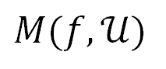
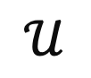
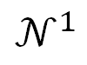
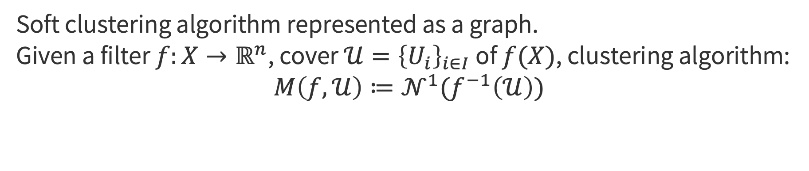
Mapper
Soft clustering algorithm represented as a graph.
Given a filter $f:X→ℝ^{n}$, cover $𝒰={\left\{U_{i}\right\}}_{i∈I}$ of $f(X)$, clustering algorithm:
$$M\left(f,𝒰\right)≔𝒩^{1}(f^{−1}\left(𝒰\right))$$
$$𝒰$$
$$U_{1}$$
$$M(f,𝒰)$$
$$f$$
$$U_{2}$$
$$f^{−1}$$
$$𝒩^{1}$$
$$U_{3}$$
$$X$$
$$U_{4}$$
$$ℝ$$

Slide 9
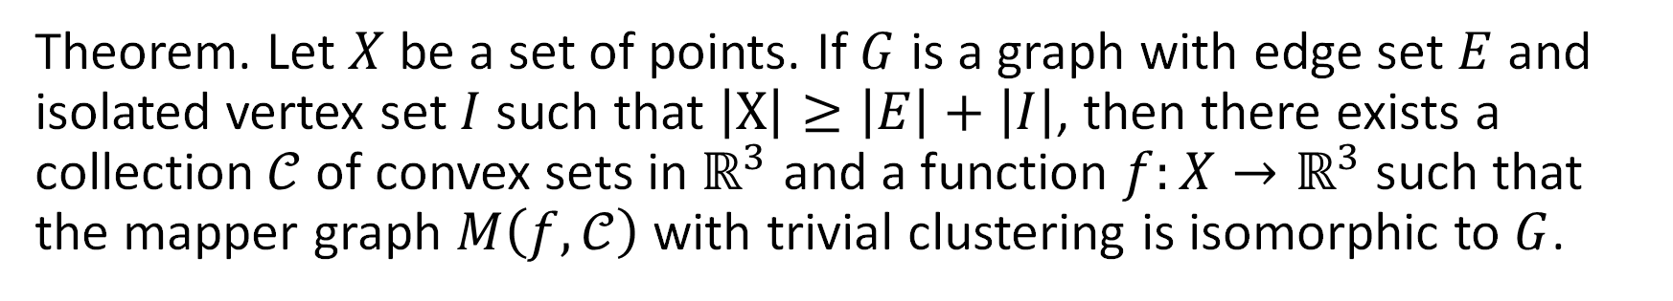
Any graph is a mapper graph
Theorem. Let $X$ be a set of points. If $G$ is a graph with edge set $E$ and isolated vertex set $I$ such that $\left|X\right|≥\left|E\right|+\left|I\right|$, then there exists a collection $𝒞$ of convex sets in $ℝ^{3}$ and a function $f:X→ℝ^{3}$ such that the mapper graph $M\left(f,𝒞\right)$ with trivial clustering is isomorphic to $G$.
Enrique G Alvarado, Robin Belton, Kang-Ju Lee, Sourabh Palande, Sarah Percival, Emilie Purvine, and Sarah Tymochko. Any graph is a mapper graph, 2024.

Slide 10
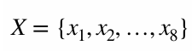
Any graph is a mapper graph
Theorem. Let $X$ be a set of points. If $G$ is a graph with edge set $E$ and isolated vertex set $I$ such that $\left|X\right|≥\left|E\right|+\left|I\right|$, then there exists a collection $𝒞$ of convex sets in $ℝ^{3}$ and a function $f:X→ℝ^{3}$ such that the mapper graph $M\left(f,𝒞\right)$ with trivial clustering is isomorphic to $G$.
Enrique G Alvarado, Robin Belton, Kang-Ju Lee, Sourabh Palande, Sarah Percival, Emilie Purvine, and Sarah Tymochko. Any graph is a mapper graph, 2024.

Slide 11
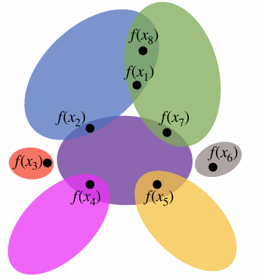
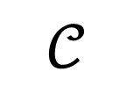
Any graph is a mapper graph
Theorem. Let $X$ be a set of points. If $G$ is a graph with edge set $E$ and isolated vertex set $I$ such that $\left|X\right|≥\left|E\right|+\left|I\right|$, then there exists a collection $𝒞$ of convex sets in $ℝ^{3}$ and a function $f:X→ℝ^{3}$ such that the mapper graph $M\left(f,𝒞\right)$ with trivial clustering is isomorphic to $G$.
$$𝒞$$
$$f$$
Enrique G Alvarado, Robin Belton, Kang-Ju Lee, Sourabh Palande, Sarah Percival, Emilie Purvine, and Sarah Tymochko. Any graph is a mapper graph, 2024.

Slide 12
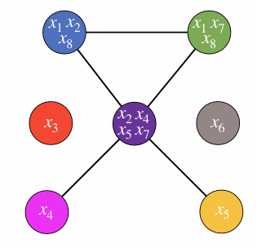
Any graph is a mapper graph
Theorem. Let $X$ be a set of points. If $G$ is a graph with edge set $E$ and isolated vertex set $I$ such that $\left|X\right|≥\left|E\right|+\left|I\right|$, then there exists a collection $𝒞$ of convex sets in $ℝ^{3}$ and a function $f:X→ℝ^{3}$ such that the mapper graph $M\left(f,𝒞\right)$ with trivial clustering is isomorphic to $G$.
$$𝒞$$
$$f$$
Enrique G Alvarado, Robin Belton, Kang-Ju Lee, Sourabh Palande, Sarah Percival, Emilie Purvine, and Sarah Tymochko. Any graph is a mapper graph, 2024.

Slide 13
New questions
Is this theorem constructible?
Given a graph G can we algorithmically find convex sets which satisfy our theorem?

Slide 14
New questions
Is this theorem constructible?
Given a graph G can we algorithmically find convex sets which satisfy our theorem?
What happens when we apply different conventional parameters to Mapper?
cover choice
non-trivial clustering algorithms

Slide 15
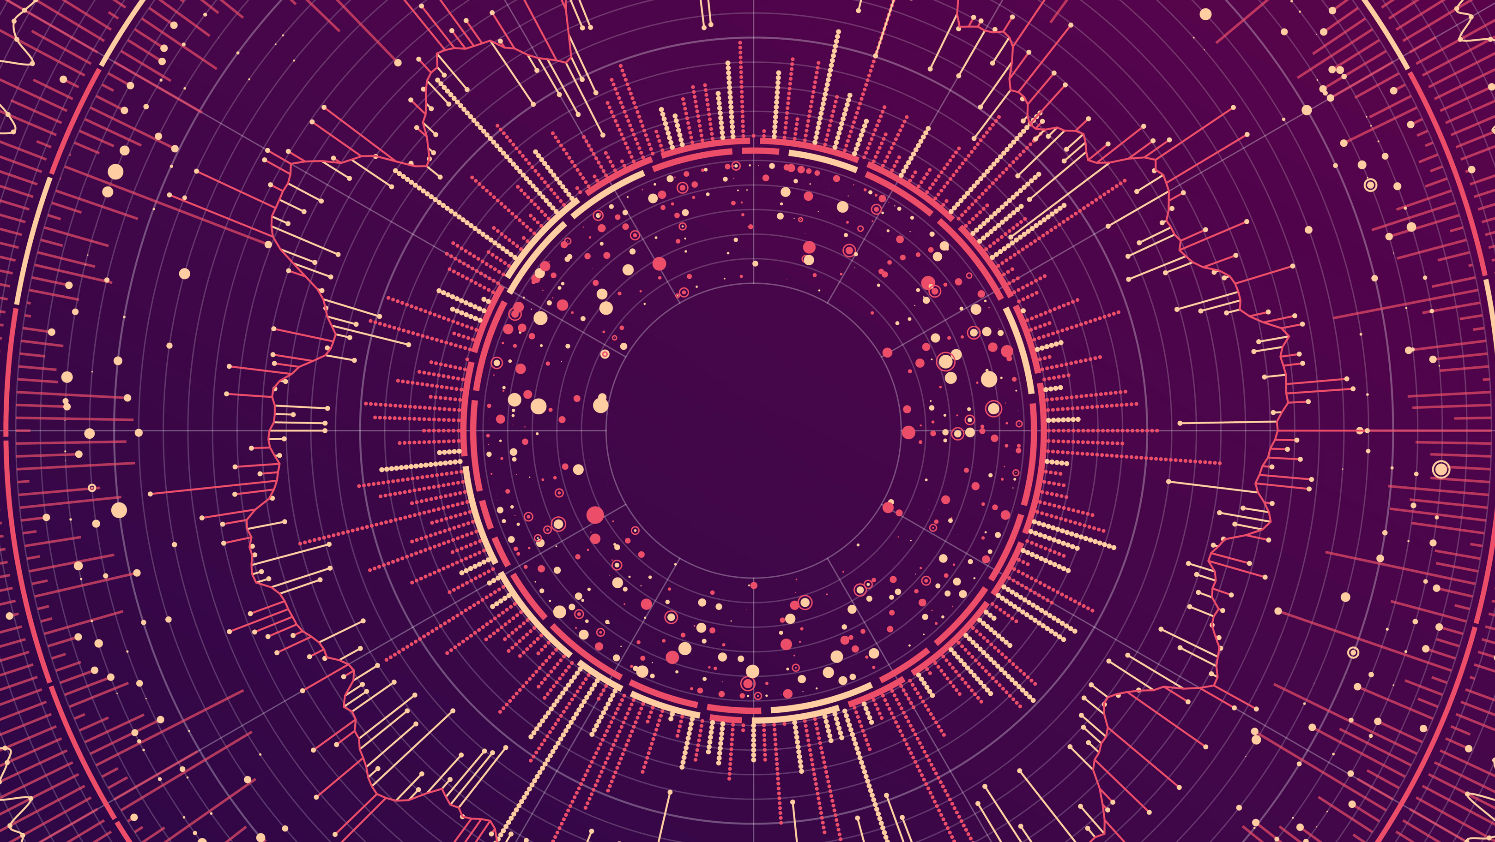
Convex sets

Slide 16
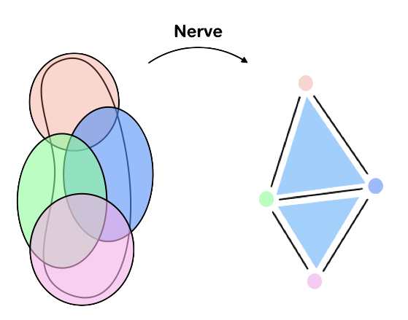
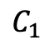
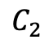
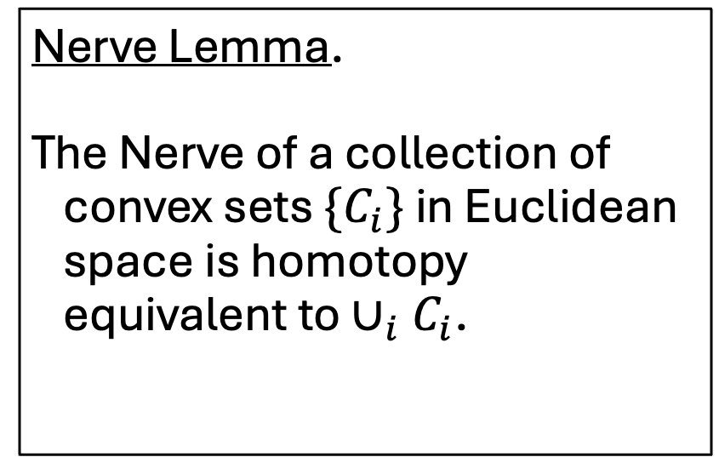
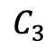
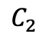
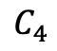
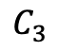
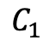
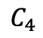
Nerve Lemma.
The Nerve of a collection of convex sets $\{C_{i}\}$ in Euclidean space is homotopy equivalent to $∪_{i}C_{i}$.
$$C_{1}$$
$$C_{1}$$
$$C_{2}$$
$$C_{3}$$
$$C_{2}$$
$$C_{3}$$
$$C_{4}$$
$$C_{4}$$

Slide 17
Input: some graph G

Slide 18
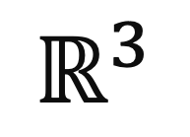
Output: convex sets in whose nerve is G
Input: some graph G
$$ℝ^{3}$$

Slide 19
Step 1: preprocessing

Slide 20
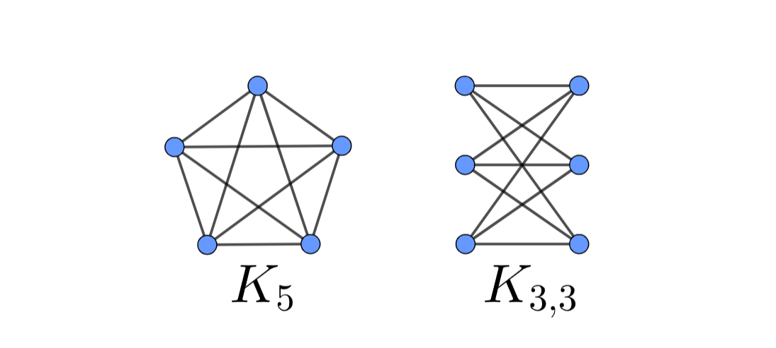
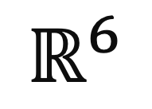
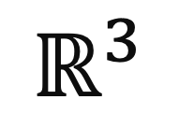
Step 2: planarity check
$$ℝ^{3}$$
$$ℝ^{6}$$

Slide 21
Step 3: MDS embedding
adjacent
…or not

Slide 22
Step 4: optimization
No shared edge?
objective function:
minimize the sum of radii and centers
disjoint balls

Slide 23
(Step 5: projection to 3D)
planar
solution found

Slide 24
Step 6: nerve computation
convex sets

Slide 25
Step 7: verification
convex sets
= G?

Slide 26
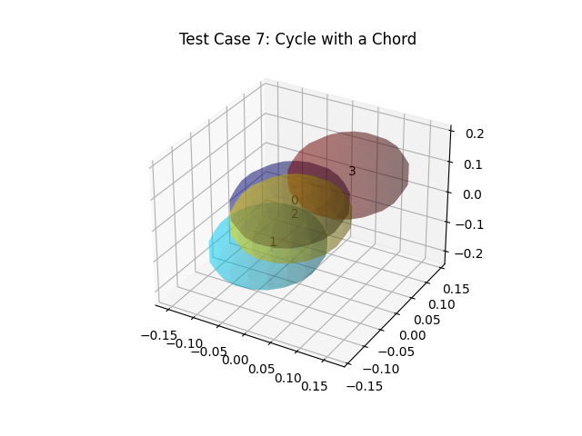

Slide 27
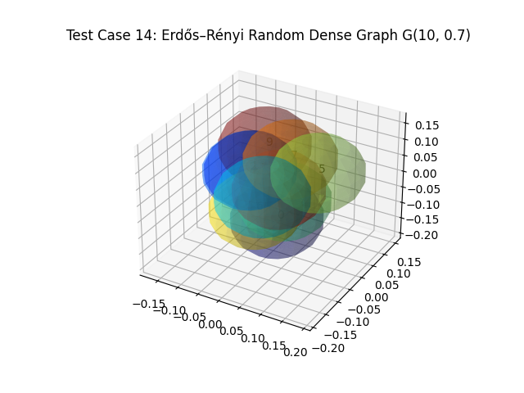

Slide 28
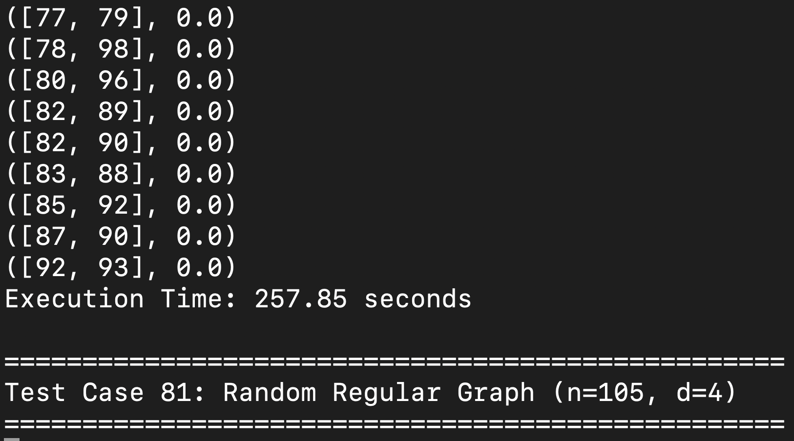
(Step 8: extras)

Slide 29
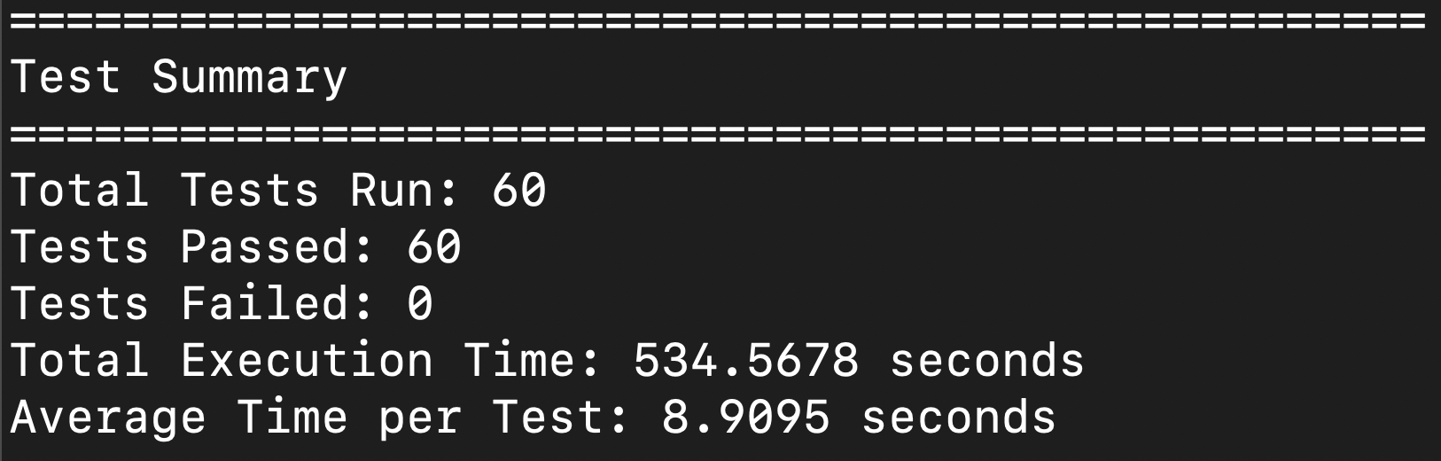

Slide 30
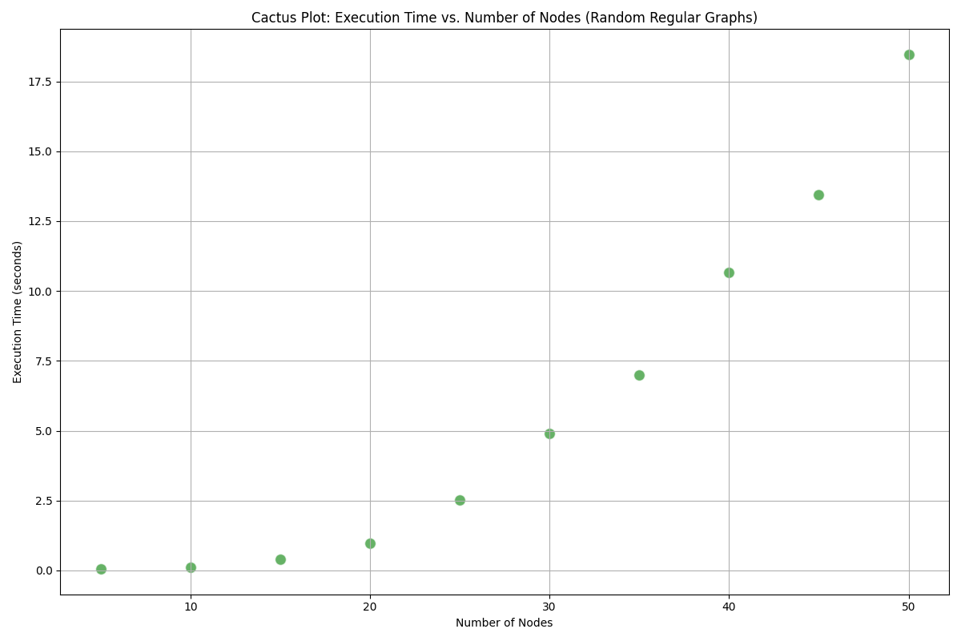

Slide 31
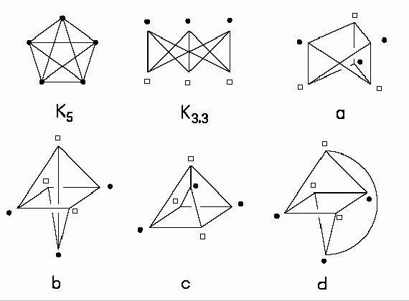
Limitations
heuristic
planarity

Slide 32
Mapper’s Probability Space on a Line

Slide 33
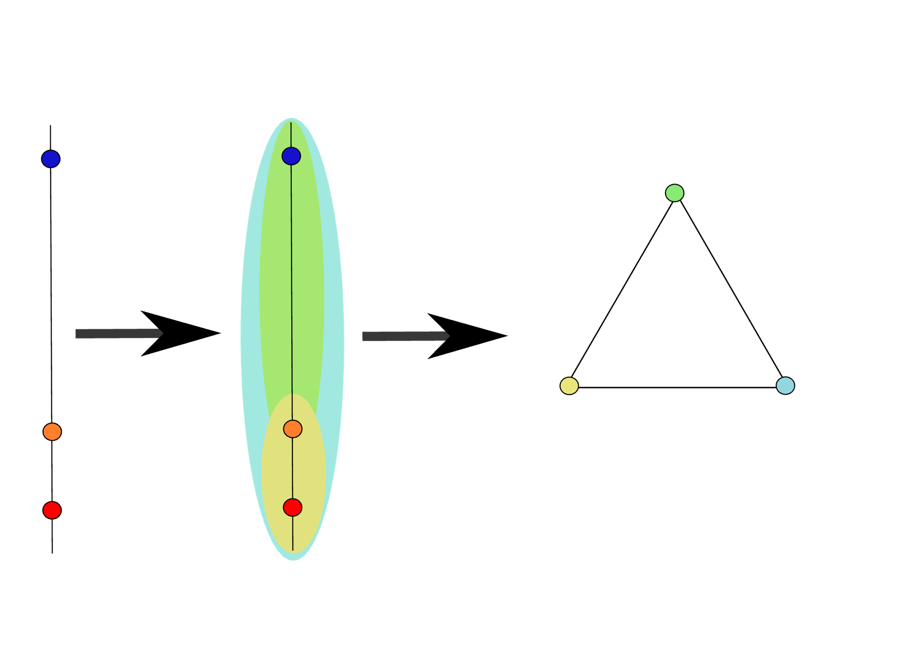
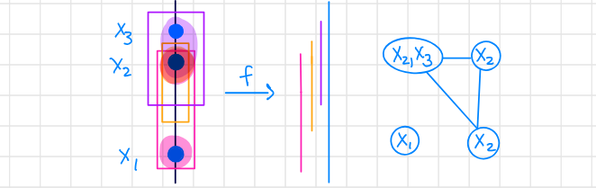
The Triangle Example
Notes:
The problem we considered involved three points on a line, two of which were very close together, and one of which was very far apart. We wanted to know if it was always possible to create a triangle out of these three points using a filter function taking the y coordinates.
The figure on the right shows the triangle example with trivial clustering, and the one on the right shows a fail with nontrivial clustering.

Slide 34
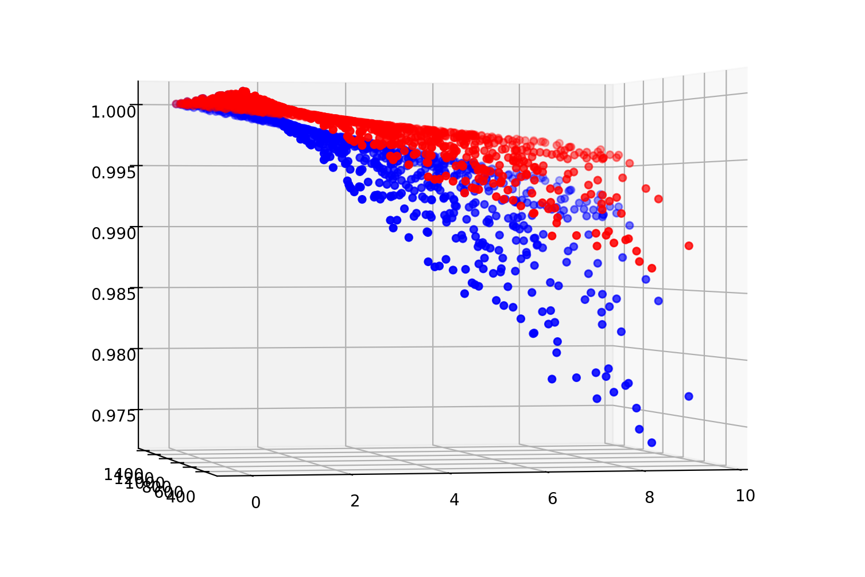
Varying parameters
KMeans
DBScan
Notes:
This graph uses a bisection algorithm to minimize the overlap fraction in order to have one connected component. It looks at two different clustering algorithms. KMeans (red), and DBScan (blue). They both use a filter function that takes the y coordinates. The number of clusters in the KMeans clustering algorithm is set to 1. This allows us to analyze the minimum overlap fraction required to get a triangle.

Slide 35
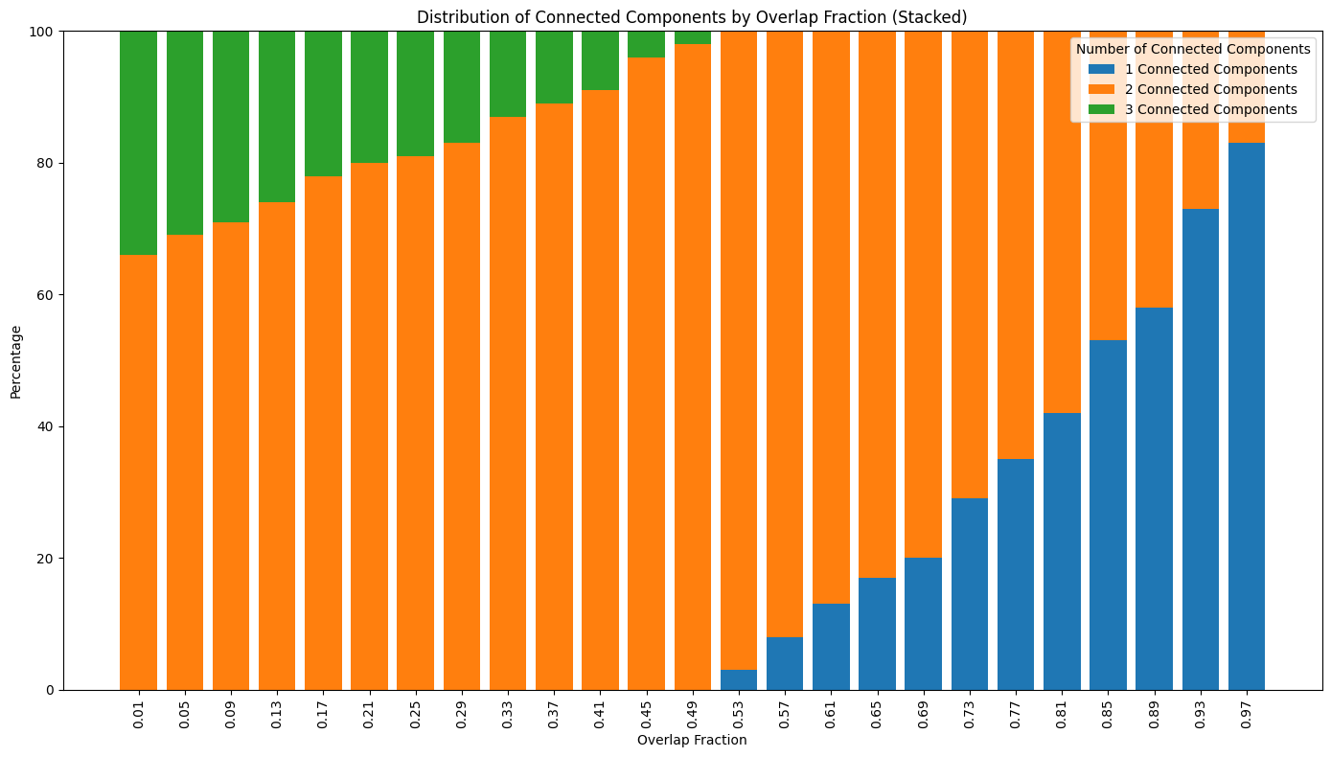
Looking at DBScan
Notes:
Because there was a lower overlap fraction needed to have one connected component for DBScan, we decided to investigate it further. Another way to visualize this is to look at the proportion of graphs that have one connected component compared to two connected components. This allows us to analyze the relationship between connected components and overlap fraction. The above figure suggests that there is an almost linear increase in the proportion of graphs with one connected component as the overlap fraction increases.

Slide 36
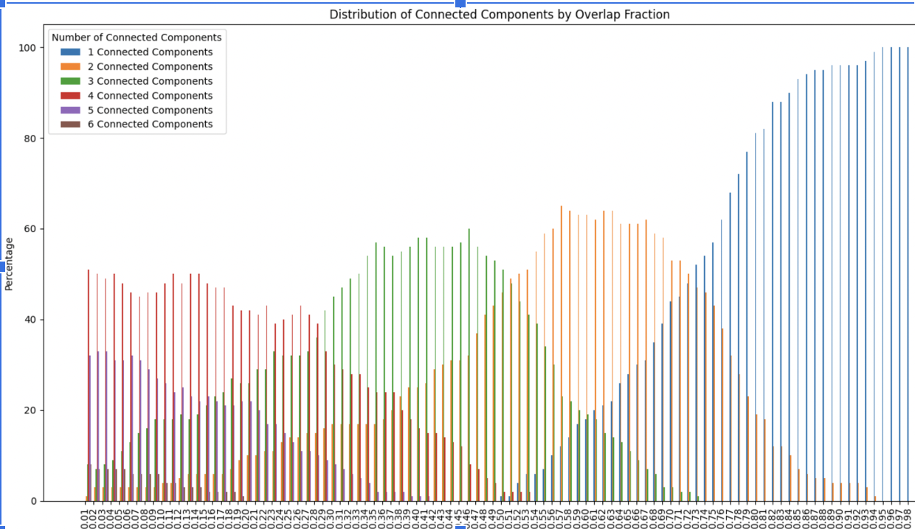
Extending our Analysis
Notes:
We also looked at more than three points on a line to analyze connected components. This figure shows how it seems that some of the data is almost normally distributed. Once the overlap fraction gets large enough, though, the proportion with one connected component dominates.

Slide 37
Further Research
compare differences in graphs using optimal transport and the Wasserstein distance​
study more complex data​
analyze additional graph characteristics

Slide 38
Thank You!

